Slide 1
Eclipse Modeling Framework (EMF)
Paweł Żalejko

Slide 2
Agenda
Model-Driven Development
What is EMF?
EMF demo - hello world
EMF demo - command stack & adapters
EMF demo - data binding & validation
EMF demo - generating UI editors

Slide 3
Agenda
Model-Driven Development
What is EMF?
EMF demo - hello world
EMF demo - command stack & adapters
EMF demo - data binding & validation
EMF demo - generating UI editors

Slide 4
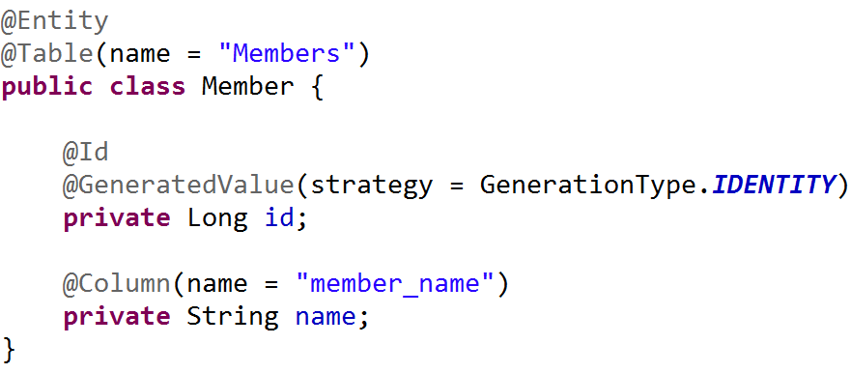
Model-Driven Development

Slide 5
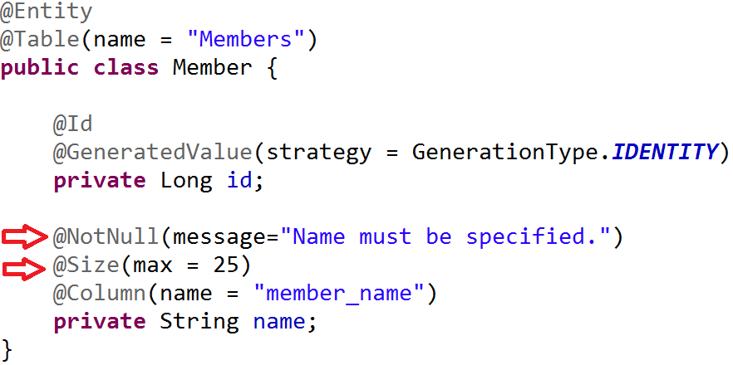
Model-Driven Development

Slide 6
Model-Driven Development
Clear visibility
Flexibility(models can be adjusted)
Fast & cost-effective
Leads to increased quality
Enforces architecture
Let’s programmers focus on the hard stuff

Slide 7
Agenda
Model-Driven Development
What is EMF?
EMF demo - hello world
EMF demo - command stack & adapters
EMF demo - data binding & validation
EMF demo - generating UI editors

Slide 8
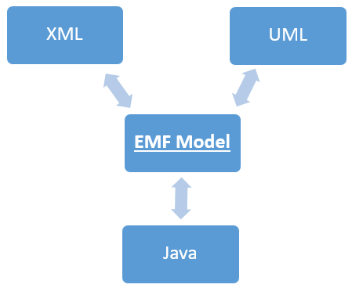
What is EMF?
Modeling framework
Code generator
Framework for building tools and applications based on a structured data model

Slide 9
EMF - frameworks
Persistence
CDO, EMFStore, Teneo
UI frameworks
EMF Forms
Graphical Modeling
GMF, Sirius
Textual Modeling
Xtext
And much more...
https://eclipse.org/modeling/

Slide 10
Agenda
Model-Driven Development
What is EMF?
EMF demo - hello world
EMF demo - command stack & adapters
EMF demo - data binding & validation
EMF demo - generating UI editors

Slide 11
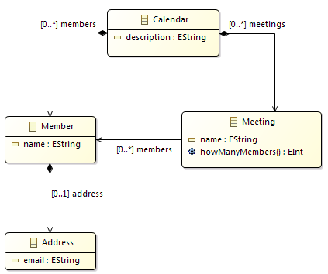
EMF demo - hello world
Create a model
Eclipse Modeling IDE
Create a new Ecore Modeling Project
Generate the code
About the model:
4 classes
Integer and String attributes
1 operation (method)
Containment and non containment refs.

Slide 12
EMF – ecore & genmodel
Two files:
ecore - contains the information about the defined classes
genmodel - contains information for the code generation

Slide 13
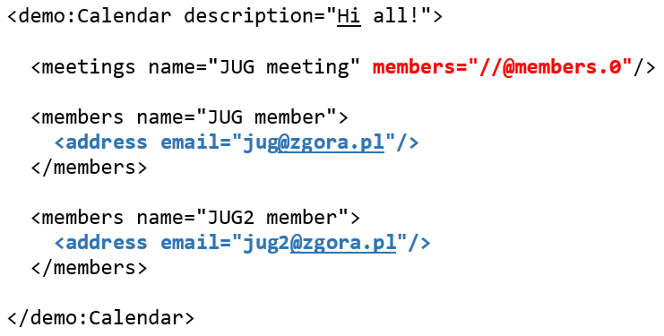
EMF – containment vs non containment

Slide 14
http://www.eclipse.org/emf/2002/GenModel
documentation
copyright
body
suppressedGetVisibility
suppressedSetVisibility
...

Slide 15
Object vs EObject
EObject is the root of all modeled objects
It provides support for the behaviors and features common to all modeled objects:
Reflection | Content
eClass eGet eSet ... | eResource eContainer eContents ...

Slide 16
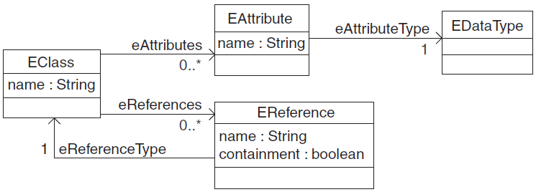
EMF – Ecore (Meta) Model
model of a model ☺:
EClass
EStructuralFeature
EAttribute
EReference
EOperation
EDataType

Slide 17
Agenda
Model-Driven Development
What is EMF?
EMF demo - hello world
EMF demo - command stack & adapters
EMF demo - data binding & validation
EMF demo - generating UI editors

Slide 18

EMF demo - command stack & adapters
Editing objects using commands
Undo/redo
Adapters as change listeners

Slide 19
Agenda
Model-Driven Development
What is EMF?
EMF demo - hello world
EMF demo - command stack & adapters
EMF demo - data binding & validation
EMF demo - generating UI editors

Slide 20
EMF demo - data binding & validation
Binding a model to UI controls
DataBindingContext
IObservableValue
UpdateValueStrategy
Validating inputs
Java
Object Constraint Language (OCL)

Slide 21
Agenda
Model-Driven Development
What is EMF?
EMF demo - hello world
EMF demo - command stack & adapters
EMF demo - data binding & validation
EMF demo - generating UI editors

Slide 22
EMF demo - generating a UI editor
A simple UI editor created using EMF Forms framework
UI:
JavaFX
SWT
Eclipse RAP
http://www.eclipse.org/ecp/emfforms/

Slide 23
EMF demo - generating a Sirius-based editor
Sirius:
„Sirius is an Eclipse project which allows you to easily create your own graphical modeling workbench by leveraging the Eclipse Modeling technologies, including EMF and GMF.”
https://eclipse.org/sirius/overview.html

Slide 24

Thanks!
https://eclipse.org/modeling/
https://eclipse.org/modeling/emf/
http://www.eclipse.org/modeling/emf/docs/
http://www.eclipse.org/ecp/emfforms/
https://eclipse.org/sirius/overview.html

